Slide 1

VariantSpark: applying Spark-based machine learning methods to genomic information
By Tim Cooper
Denis C. Bauer | Bioinformatics | @allPowerde
20 Oct 2015
CSIRO Health & Biosecurity

Slide 2
Talk Overview
Background: CSIRO, NGSANE
VariantSpark: rational overview
Whole Genome Analysis: Clustering samples by ethnicity

Slide 3
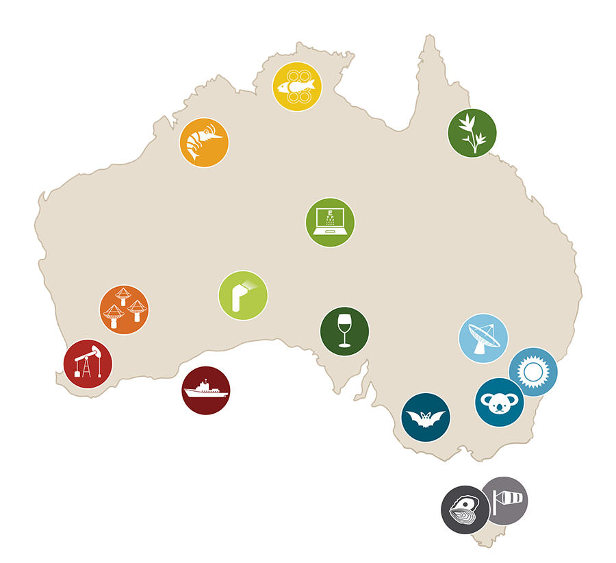
CSIRO: Australia’s government research agency
Top 10 applied research agency globally
Top 1% of global research institutions in 14 of 22 research fields
Top 0.1% in 4 research fields
2000+ industry partners totaling $220M+ per year
Key connector of Australian institutions in 6 research fields according to network analysis
Notes:
Context
Without science the world would be a very different place.
85+ years = our scientists have contributed knowledge, products, and technologies → real difference to everyday life, industries, environment.
We’re proud of the value our science delivers.
We work with over 2000 industry companies (small and large, Australian and international) and industry collaboration vehicles (CRCs and RDCs) each year.
Our work with industry totals more than $220M per annum.
Examples of CSIRO-wide impact (map)
Parkes Radio Telescope (NSW): for decades The Dish has put Australia at the forefront of space exploration
National Solar Energy Centre (NSW): we are using the sun’s energy to power future homes
Australian National Wildlife/Insect Collection (ACT): we hold one of the largest collections of native critters, used by researchers all over the world
AAHL (VIC): we are learning to fight dangerous animal diseases SARS, Hendra (collaboration = 1st vaccine, protect equine industry/human lives), border protection
Sense-T (TAS): sensor technology is putting quality oysters on our plates
Zebedee (SA): we are using lasers to create 3D maps
Indigenous Tele-eye Care (NT): broadband takes specialist eye care to our most remote communities
Atherton Arboretum (QLD): we nurture unique tropical plants
Wine Innovation Cluster (SA): we help craft quality wine
Cape Grim Baseline Air Pollution Station (TAS): the air we breathe is monitored, long record means we can measure changes in climate and air pollution
National Marine Debris Survey (NT): we are getting insight into how rubbish affects our oceans and coasts
Northern Prawn Fishery (NT/WA): Prawn = industry partnership. Northern Prawn Fishery 2nd most valuable Commonwealth fishery. (A$65M in 2011-12)
ASKAP (WA): we will find answers to the Universe’s unsolved mysteries
Australian Resources Research Centre (WA): we work towards a more sustainable future in petroleum and minerals exploration
RV Investigator (Indian Ocean): we set sail to explore our oceans
People / science areas / facilities
Close to 6000 people, 50-plus sites, five broad science areas
National facilities and collections – many on site and attract researchers from around the world.
Standing
Our people = passionate, world-class science.
Top 10 applied research agencies in the world for many years

Slide 4









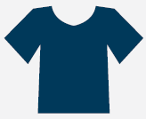
Our track record: top inventions
2. POLYMER BANKNOTES
3. RELENZA FLU VACCINE
4. EXTENDED WEAR CONTACTS
1. Fast WLAN Wireless Local Area Network
5. AEROGARD
6. TOTAL WELLBEING DIET
7. RAFT POLYMERISATION
8. BARLEYMAX
9. SELF TWISTING YARN
10. SOFTLY WASHING LIQUID
Notes:
While we are a research organization, we were successful at commercializing a couple of our products. Most famously the wifi protocol which is now in every device using wireless technology like your laptop or phone. Closer to my area of research is Barlymax, a cereal which is high in fibre specifically developed to reduce the risk of bowel cancer.
We have a strong track record of commercial success. Our work has impacted the daily lives of Australians and those around the world. These are some of our top inventions.

Slide 5
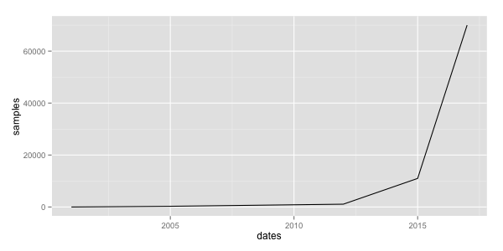

Genomics projects are getting bigger
Project MinE
15,000 people with ALS
100,000 Genomes project
70,000 individuals
by 2017
ASPREE
4000 healthy 70+ year olds
The cancer genome atlas
11,000 samples 2015
Human genome
~1 sample
The HapMap Project
270 samples 2002
1000 Genome Project
1097 samples 2012

Slide 6
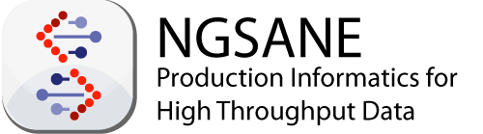
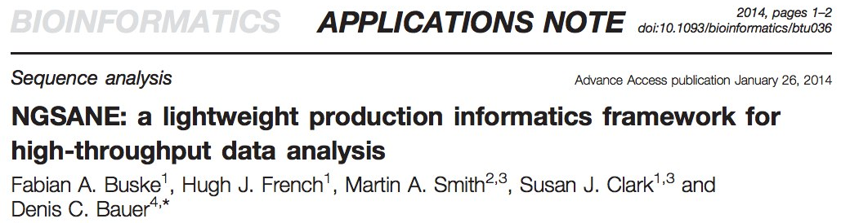
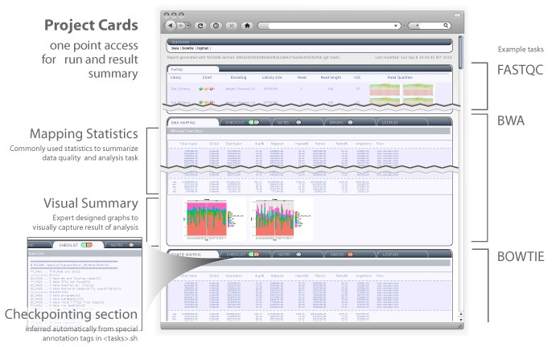
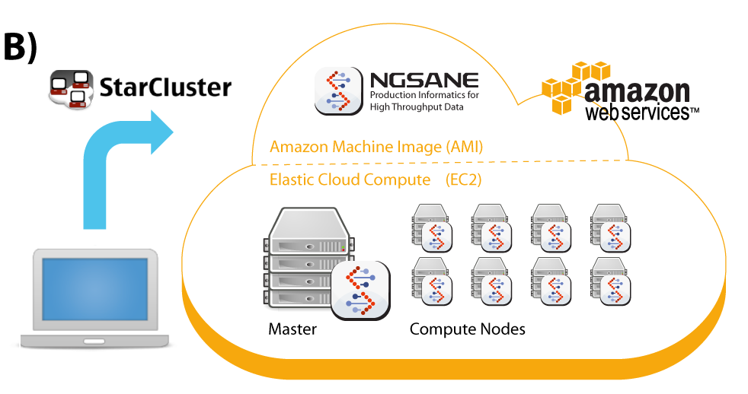
Last Year

Slide 7

Data Analysis categories for genomics
Produce raw sequence reads
Basic Production
Informatics
Map to genome and generate raw genomic features (e.g. SNPs)
Advanced
Production Inform.
Analyze the data; Uncover the biological meaning
Bioinformatics
Research

Slide 8
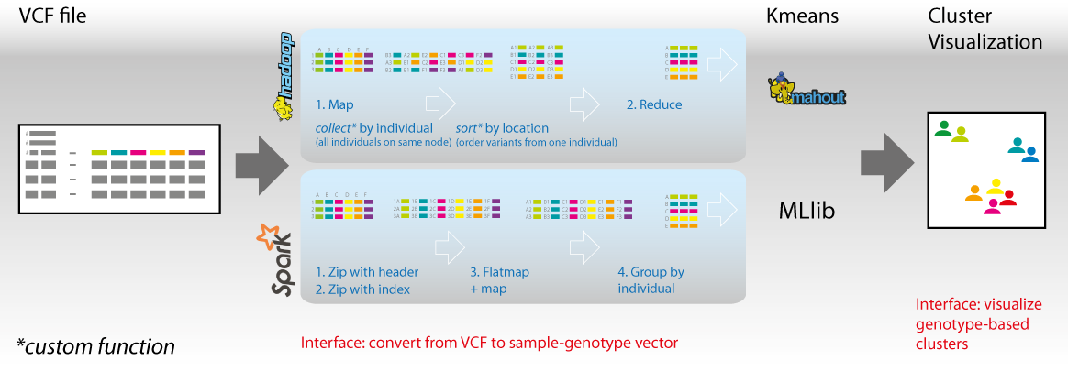
VariantSpark
VariantSpark is the interface enabling Spark’s MLlib machine learning algorithms to be applied to genomics data
Input Genomics Application Result
VCF
e.g. grouping samples by genomic profile
Large scale
compute
MLlib

Slide 9
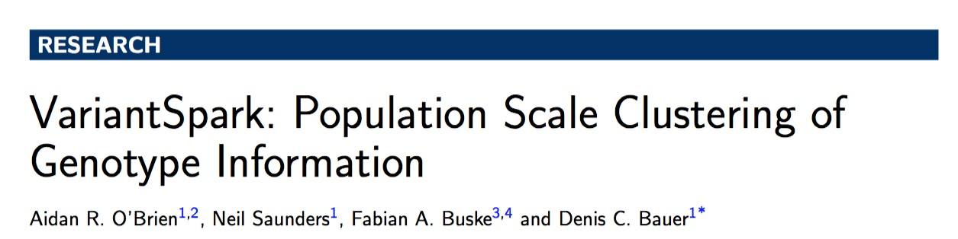
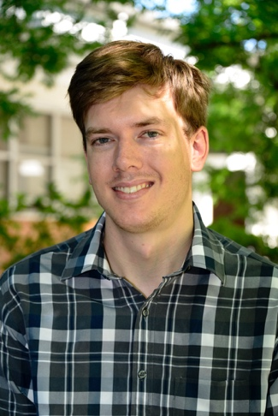
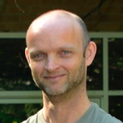


VariantSpark

Slide 10
Cluster individuals into ethnic groups based on their genomic profiles
1000 x 40 Million variants
matrix
Kmeans
14 ethnic groups and
4
Predict super
population
super
populations
www.cloudaccess.eu
Notes:
http://www.cloudaccess.eu/blog/wp-content/uploads/2014/06/genetic_roots.png

Slide 11
Clustering result
(adjusted Rand index) ARI = 0.84, with -1 (independent labeling) and 1 (perfect match)
Majority of American (AMR) individuals being placed in the same group as Europeans (EUR), likely reflecting their migrational backgrounds.
ADMIXTURE (state-of-the-art tool for population structure determination) returns a low ARI of 0.25
Admixture: Alexander, D.H., Novembre, J., Lange, K.: Fast model-based estimation of ancestry in unrelated individuals. Genome Res 19(9), 1655–1664 (2009)

Slide 12
Comparison to other implementations
103 75 29 28 18 4 min
Preprocessing: converting location-centric VCF genotypes into sample-centric numerical vectors
Clustering: Kmeans
ADAM (BigData Genomics): Spark implementation with dense matrix
Hadoop: MapReduce without in-memory caching
Chromosome 22; VM on Microsoft Azure with A7 Linux instance and 8 cores, 56GB memory running Ubuntu.

Slide 13
Scaling VariantSpark to the whole genome
Pre-processing: scales seamlessly as processes are independent
Clustering: memory consumption increases linear with number of variants (24GB) due to additional distance measurements between variants and k-means centroids
As total memory was the limiting factor on our infrastructure the number of simultaneously used nodes had to be reduced; increasing runtime.
Whole genome; Hadoop 2.5.0, managed by cloudera’s CDH 5. We use Spark 1.3.1. This 13 node cluster has a total of 416 cores and 1.22TB memory.

Slide 14
Three things to remember
VariantSpark is an interface bringing bigLearning tasks to genomics applications
VariantSpark can cluster 1000 individuals and 40 million variants in under 15 hours using minimal memory (24GB) – a task not being possible in R/python/ADMIXTURE due to memory limits.
VariantSpark outperforms ADAM (Big Data Genomcis) and equivalent Hadoop-implementation by almost an order of magnitude.
https://github.com/BauerLab/VariantSpark

Slide 15
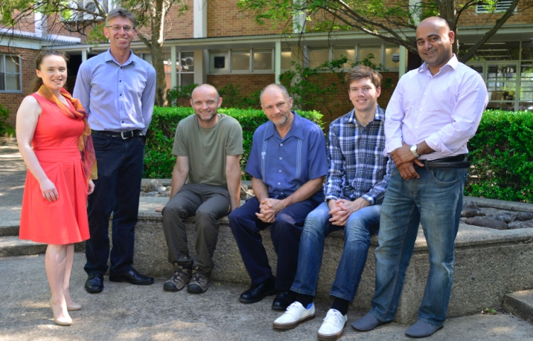
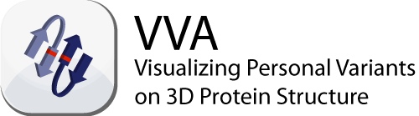


Buske et al., Bioinformatics Jan 2014
O’Brien et al., under review
Saunders et al., in preparation
FullySIC
Epistatic Gene Network
modelling
Dunne et al., in preparation
GOdistinct
GO Enrichment or genesets
with distinctive function
Anwar et al., in preparation
Thank you
Piotr Szul
Tomasz Bednarz
Computational Informatics, CSIRO, Australia
Aidan O’Brien
Bill Wilson
Firoz Anwar
Neil Saunders
Transformational Bioinformatics Team, CSIRO
Fabian A. Buske
Susan Clark
Hugh French
Martin Smith
Garvan Institute of Medical Research, Sydney, Australia
Health & Biosecurity
Denis C. Bauer t +61 2 9123 4567
e Denis.Bauer@csiro.au
w aehrc.com/biomedical-informatics/transformational-bioinformatics/
Funding:
National Health and Medical Research Council;
National Breast Cancer Foundation;
CSIRO's Transformational
Capability Platform;
CSIRO’s IM&T;
Science and Industry Endowment Fund
Health And Biosecurity
More talks online: Twitter:
http://www.slideshare.net/allPowerde @allPowerde

